Slide 1
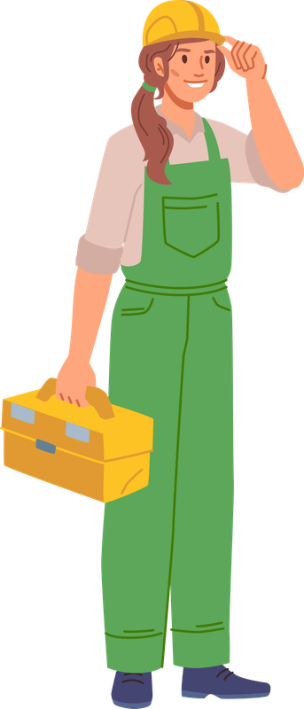

Learn ways to feel better
without making life harder.
Nailing he Basics
MOVE - Eat - Sleep - Support - Moderation
Date:
Time:
Location:
commonhealth.virginia.gov

